Slide 1
Nodejs
Node.js is an open-source, cross-platform JavaScript runtime environment
Node is an environment in which you can run JavaScript code "Outside the web browser".
It uses Google's V8 Engine to convert the JavaScript code to Machine Code.
Since Node runs JavaScript code outside the web browser, this means that it doesn't have access to certain features that are only available in the browser, like the DOM or the window object or even the localStorage

Slide 2
Nodejs Core Module
OS
File System(FS)
PATH
HTTP

Slide 3
Challenge
So, here is the challenge. Read all the instructions carefully and try it first before looking into the answers.
1: Create a folder named it abc
2: Create a file in it named bio.txt and data into it.
3: Add more data into the file at the end of the existing data.
4: Read the data without getting the buffer data at first.
5: Rename the file name to mybio.txt
6: now delete both the file and the folder?

Slide 4
Streams
Writeable
Readable
Duplex
Transform

Slide 5
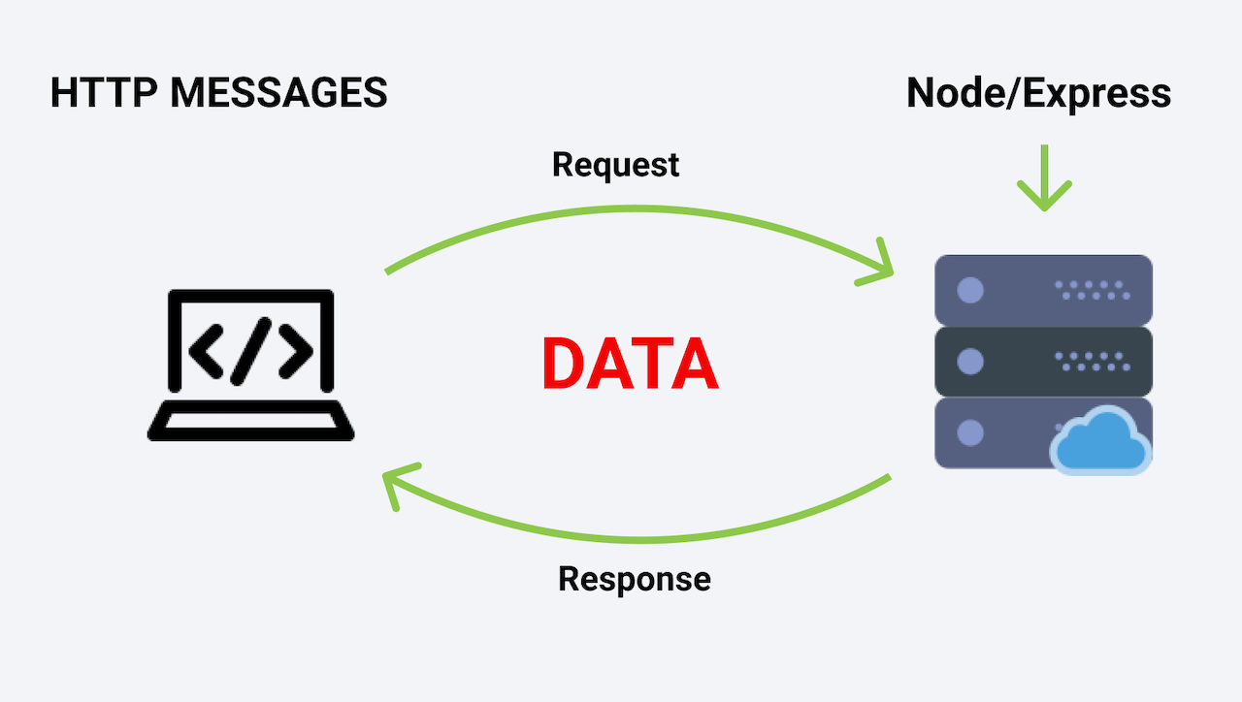

Slide 6
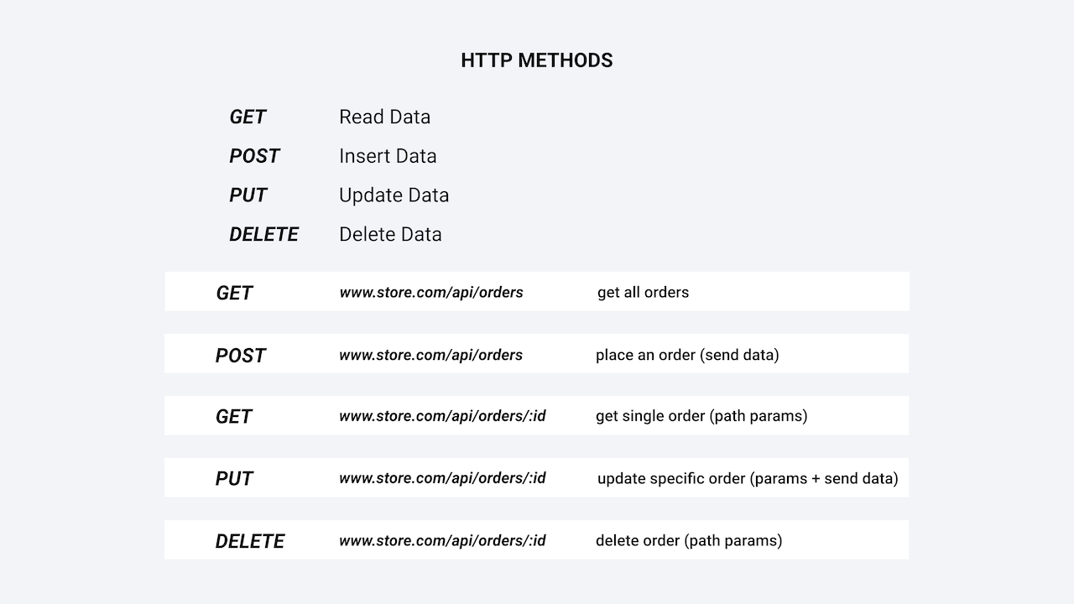

Slide 7
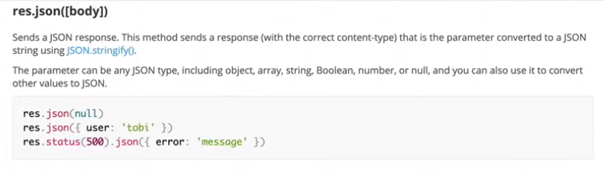
JSON response

Slide 8
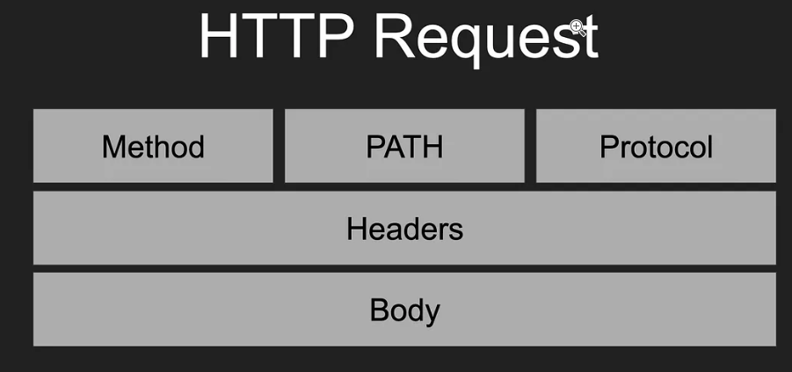
HTTP Request

Slide 9
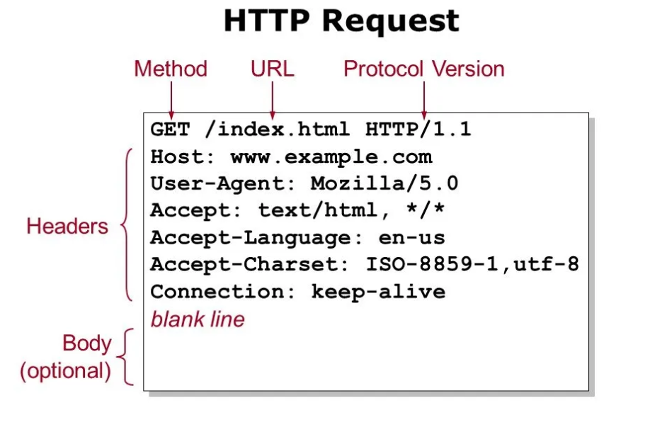
Request Message Format

Slide 10
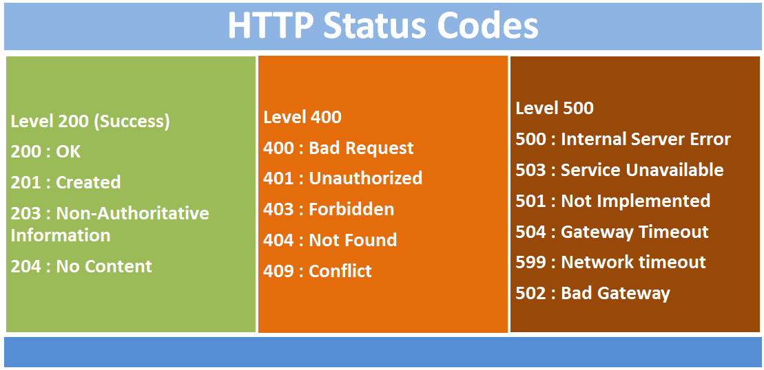

Slide 11
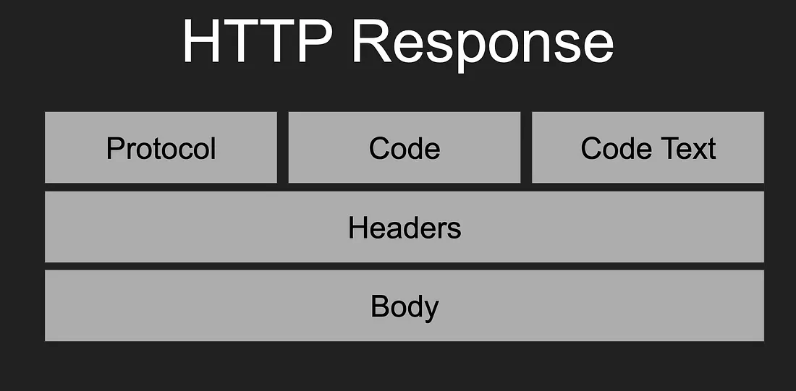
HTTP Response

Slide 12
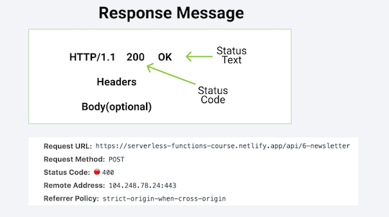

Slide 13
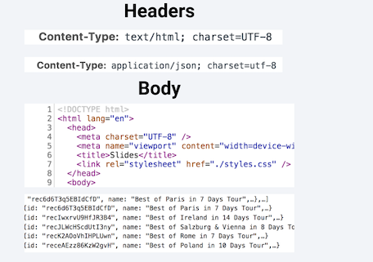

Slide 14
How does Javascript Works
Single Threaded
Non Blocking
Asynchronous
Concurrent
It has a Call Stack,an event loop , callback queue and some other apis and stuff
Does V8 have these?
I have a Call stack and a heap

Slide 15
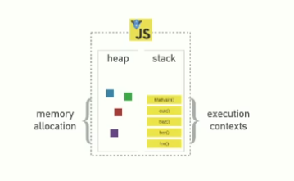

Slide 16
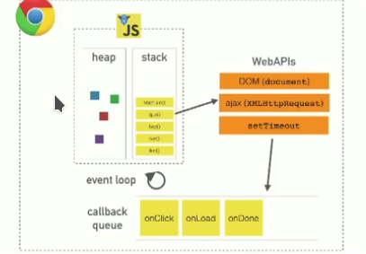
Bigger picture of JS working

Slide 17
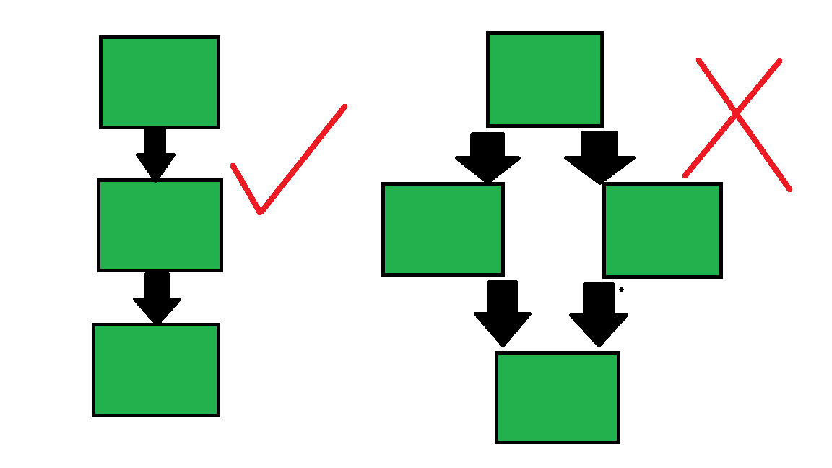
One Call Stack == One Thread == One thing at a Time

Slide 18
Call Stack
The function stack is a function that keeps track of all other functions executed in run time. Ever seen a stack trace being printed when you ran into an error in JavaScript? That is nothing but a snapshot of the function stack at that point when the error occurred.

Slide 19
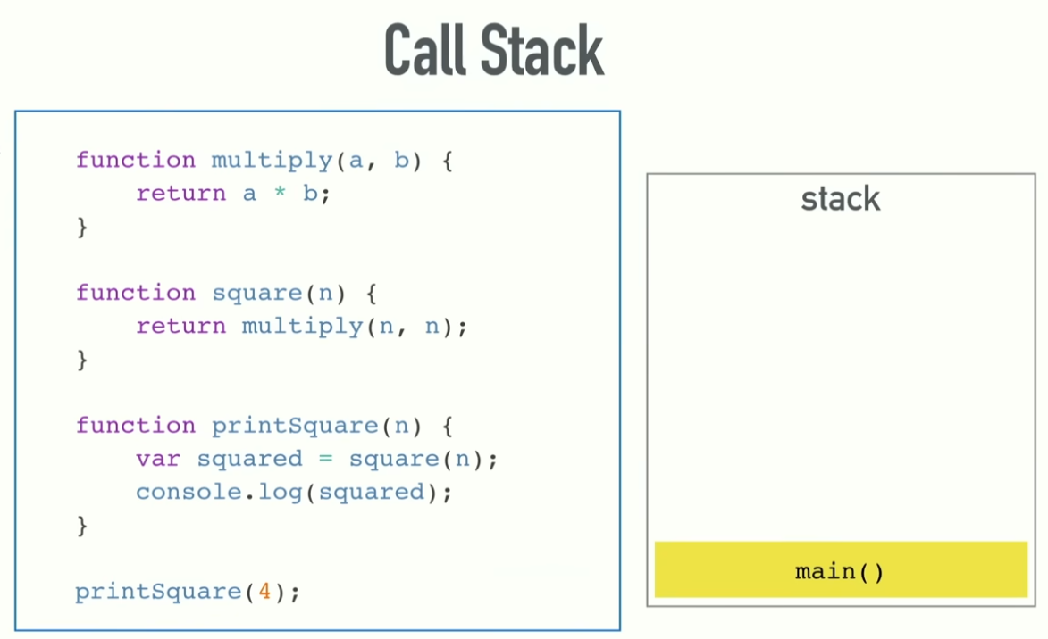
Call Stack (main here is file itself)

Slide 20
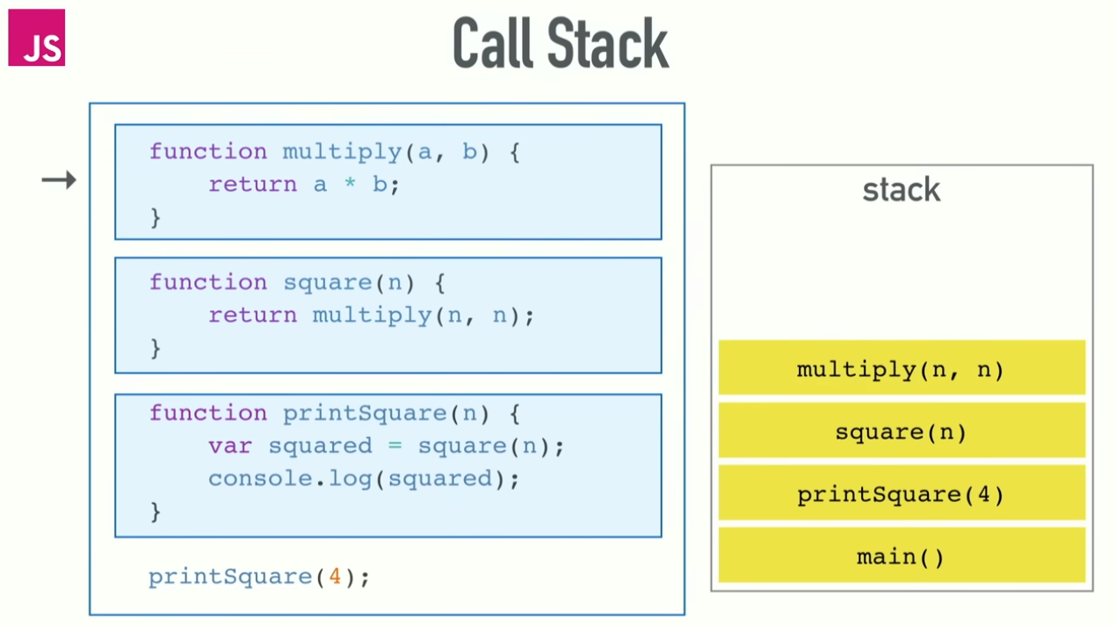
Call Stack

Slide 21
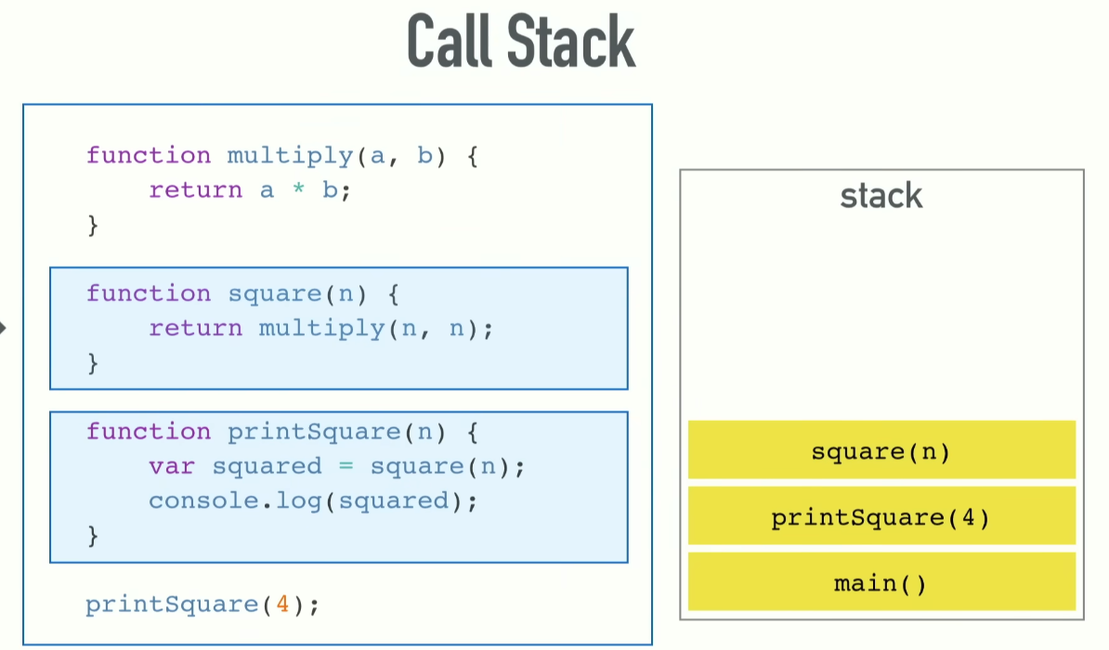
Call Stack

Slide 22
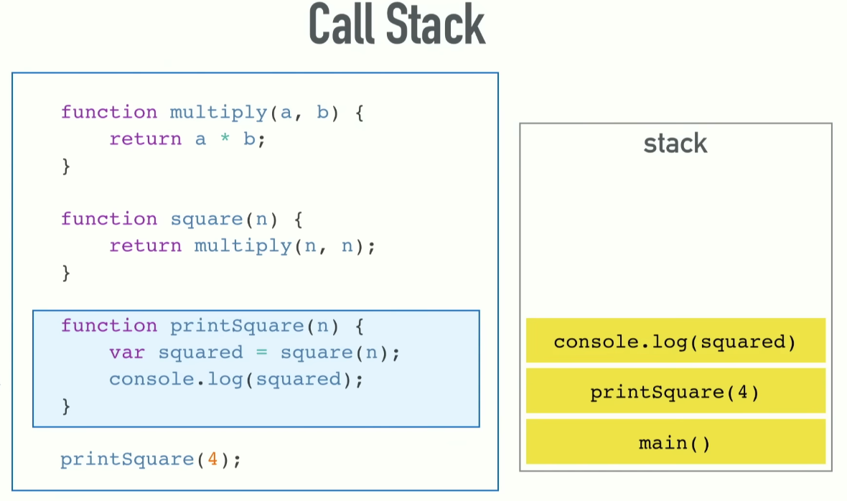
Call Stack

Slide 23
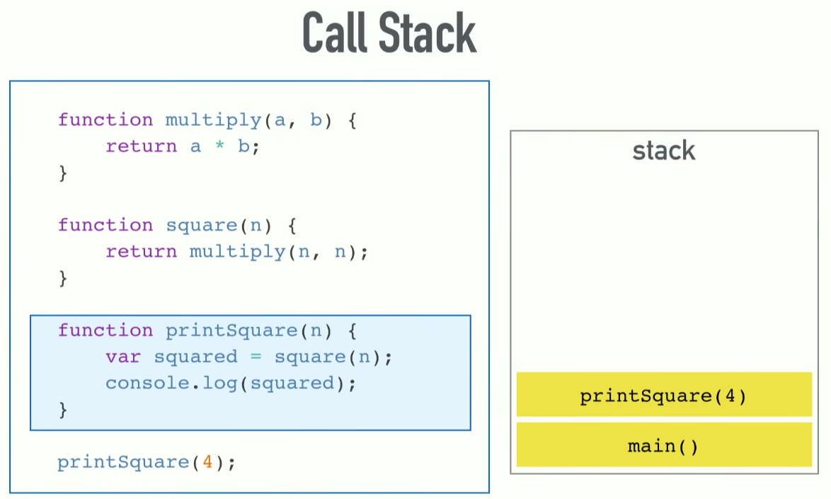
Call Stack

Slide 24
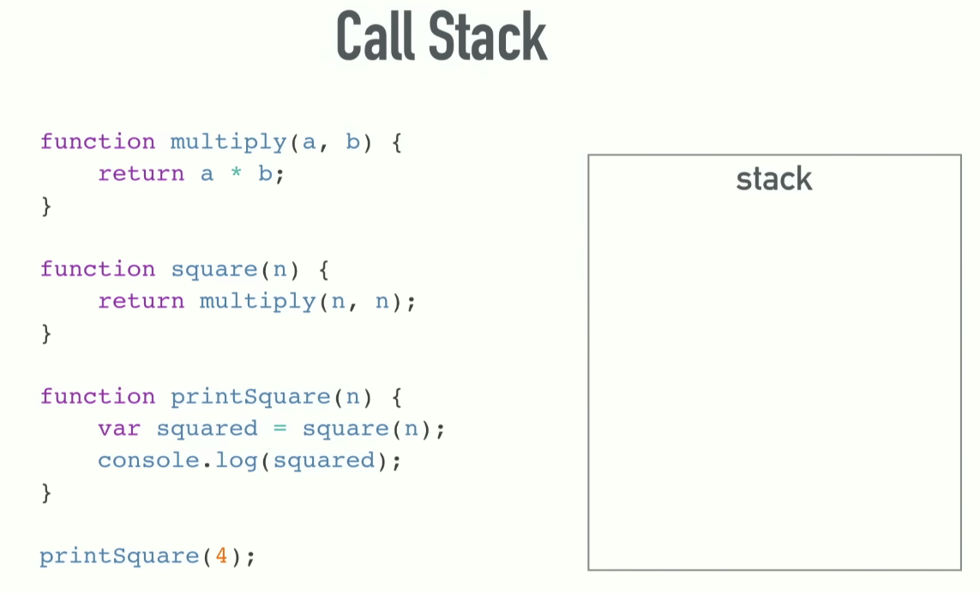
Call Stack

Slide 25
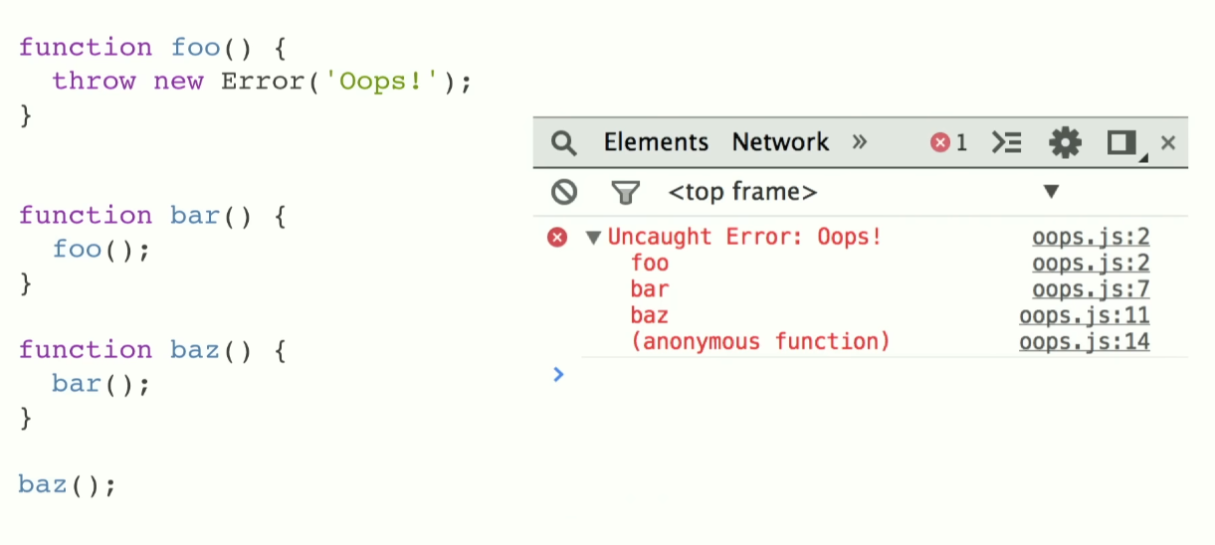
Call Stack

Slide 26
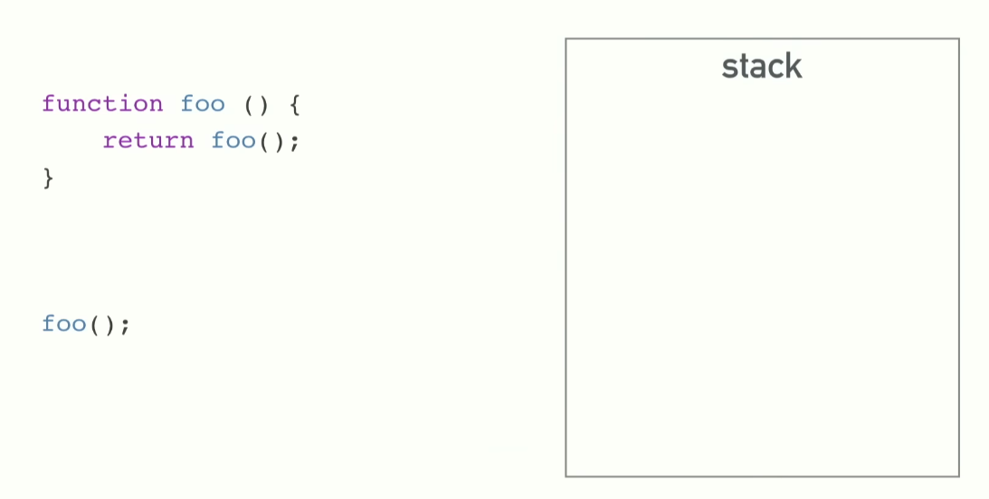
Call Stack

Slide 27
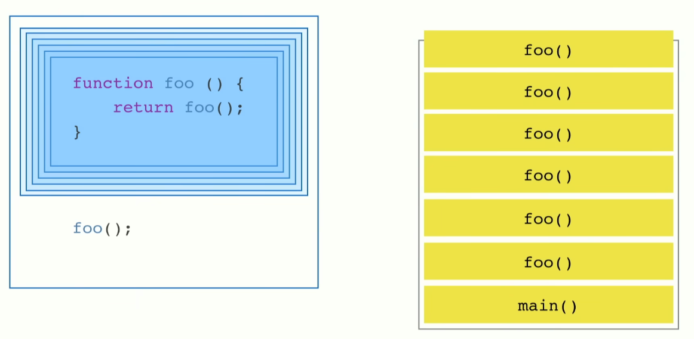
Call Stack

Slide 28
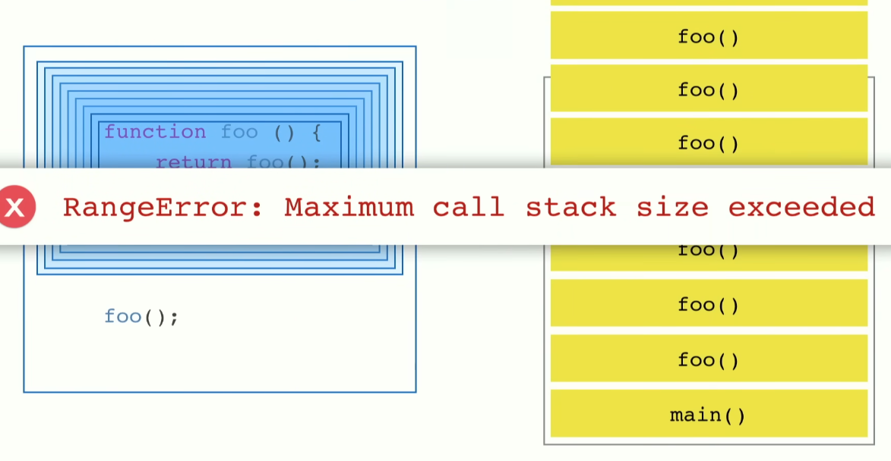
Call Stack

Slide 29
Blocking Code
Code which are slow
Example:-
Running while loop 10000000 times
Making network request
Making a Image Request

Slide 30
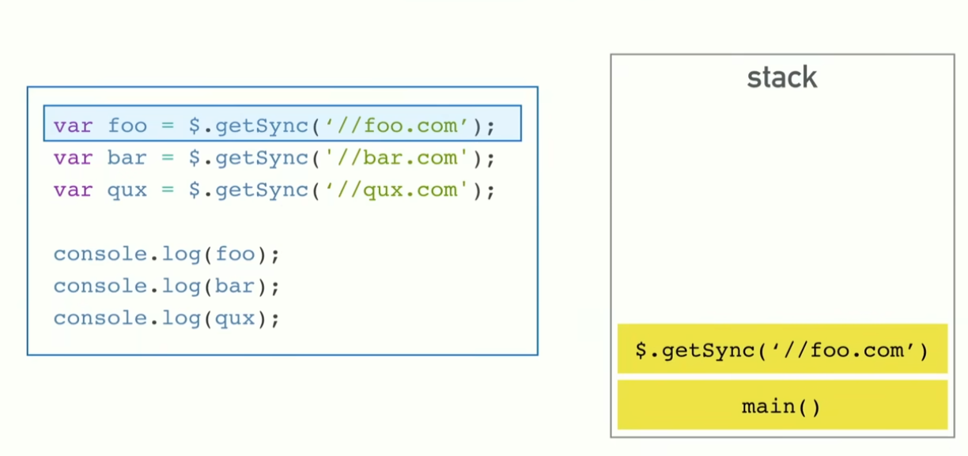
Blocking Code

Slide 31
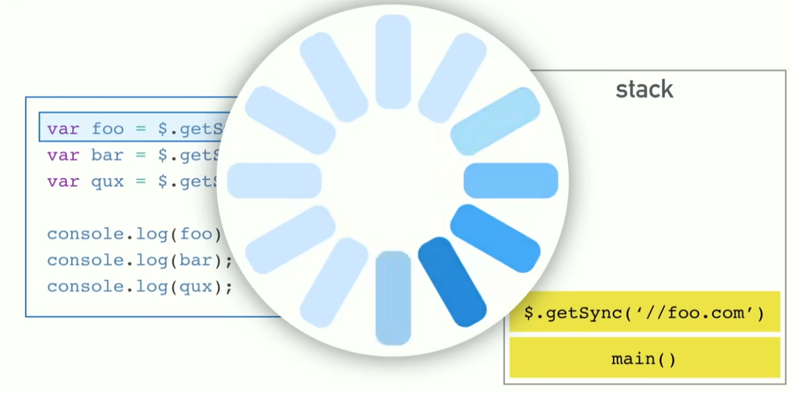
Blocking Code

Slide 32
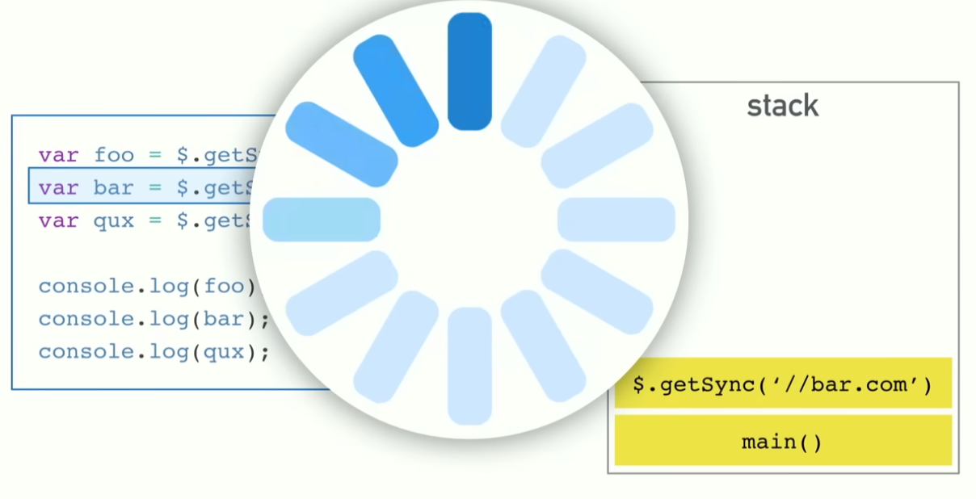
Blocking Code

Slide 33
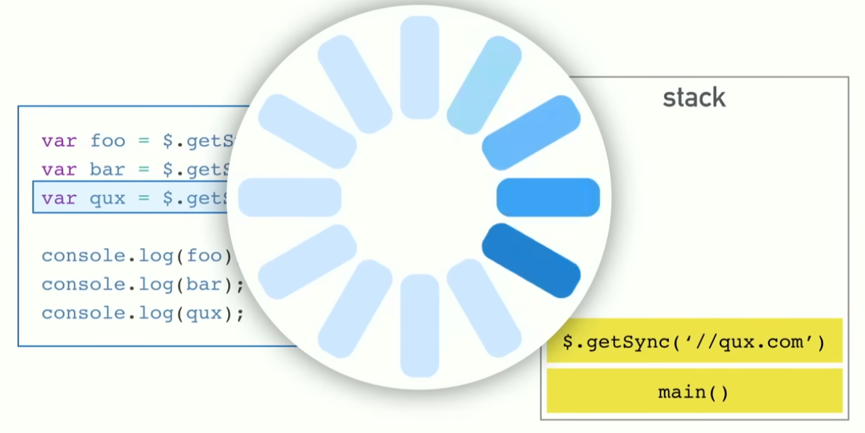
Blocking Code

Slide 34
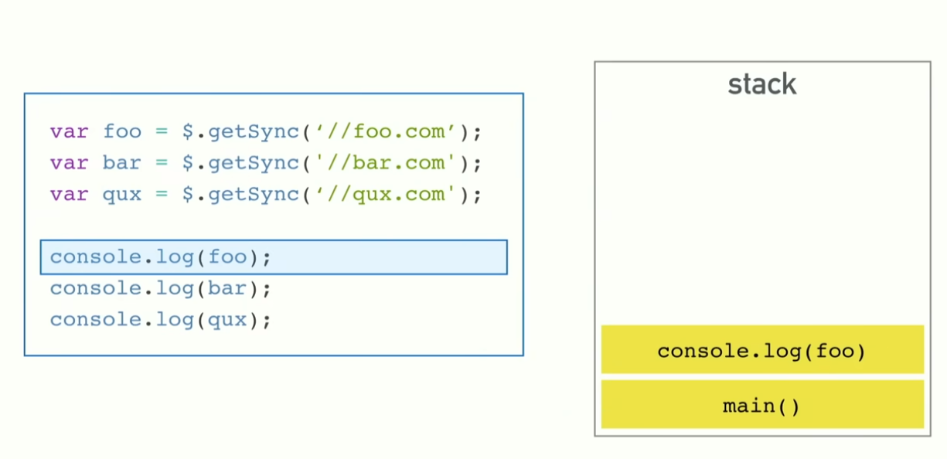
Blocking Code

Slide 35
Blocking Code
Causes the website to become slow and feel Slugish
Solution
Asynchronous Code

Slide 36
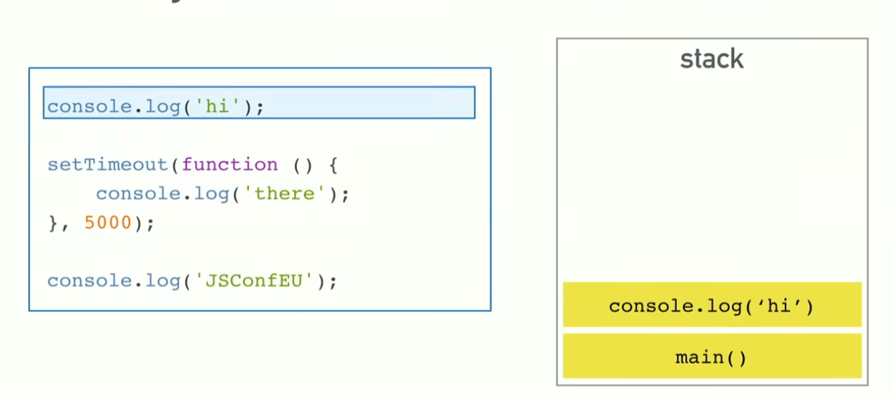
Async Code

Slide 37
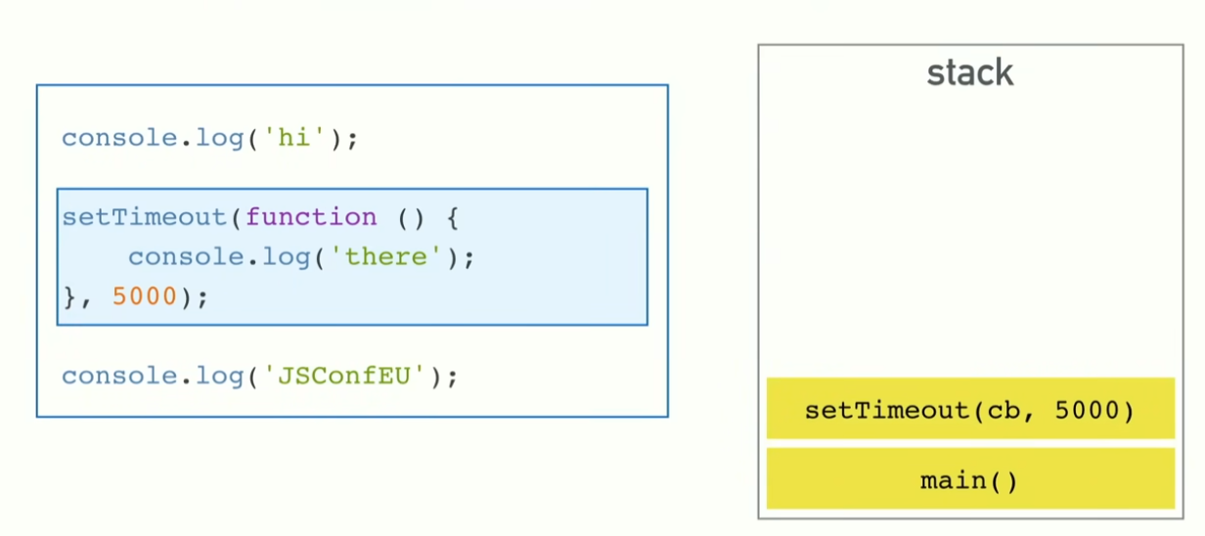
Async Code

Slide 38
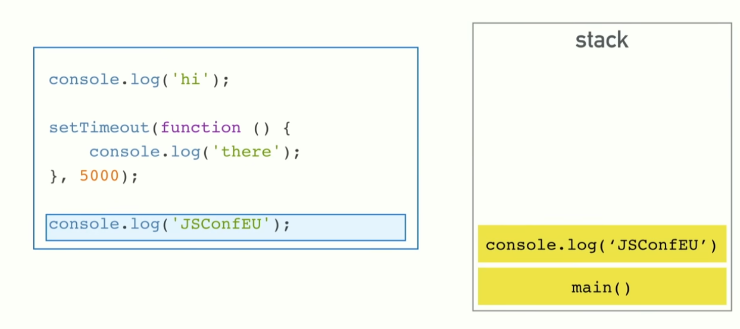
Async Code

Slide 39
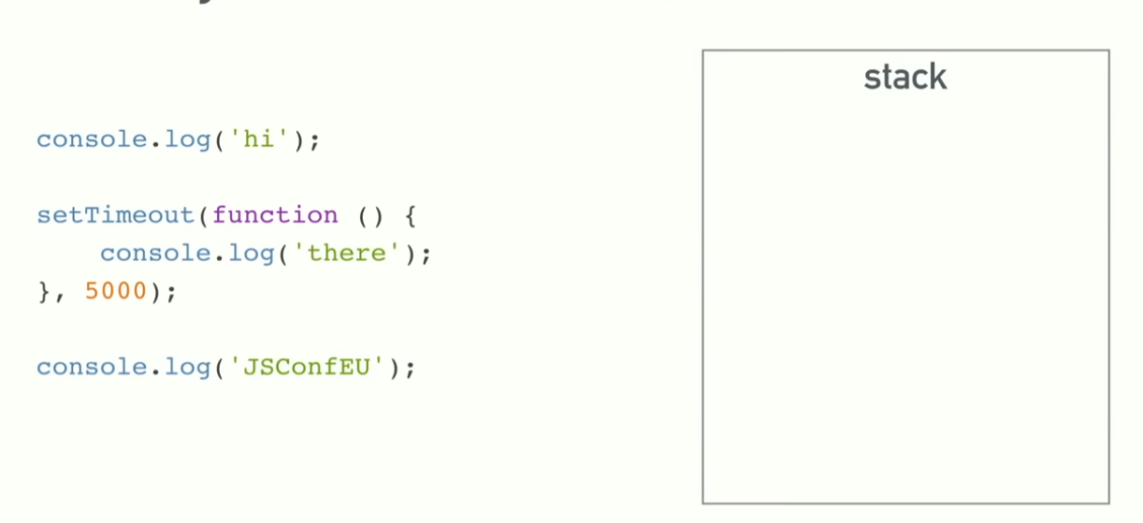
Async Code

Slide 40
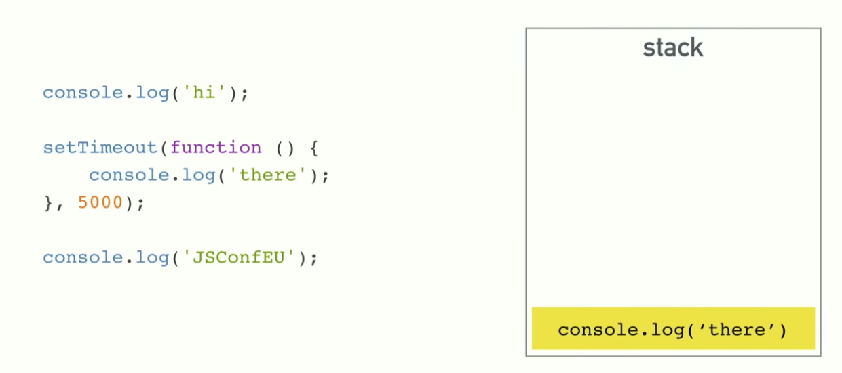
Async Code

Slide 41
Concurrency & Event Loop
Basically Javascript Runtime can only run one thing
It can’t make any request or do any other thing when runtime is doing something basically runtime can do one thing at a time
But as we have seen it seems to do multiple things at a time like making request and all this is because the browser is more than Runtime
Like webapi creates new thread
It also has callback queue thread
And event loop

Slide 42
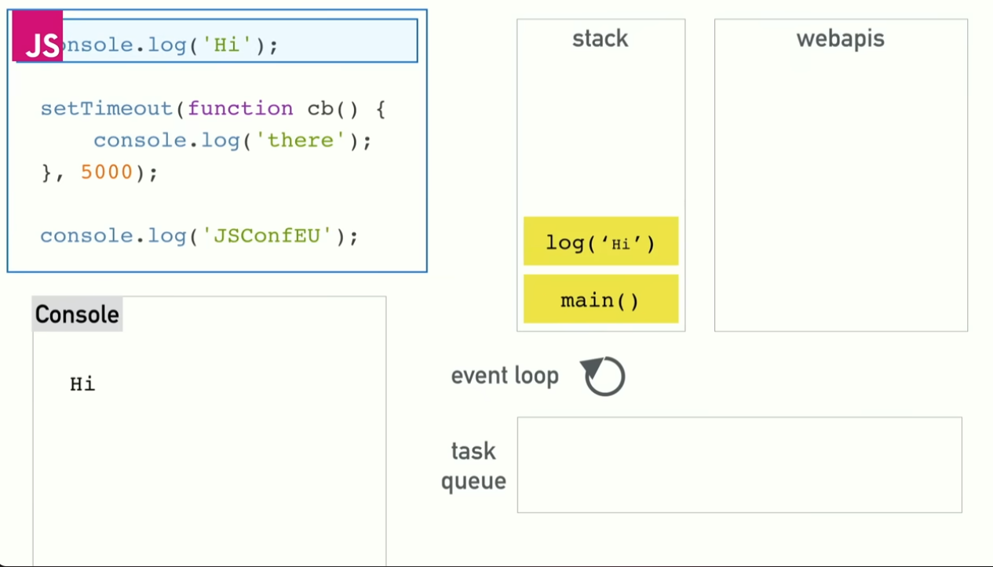
Concurrency & Event Loop

Slide 43
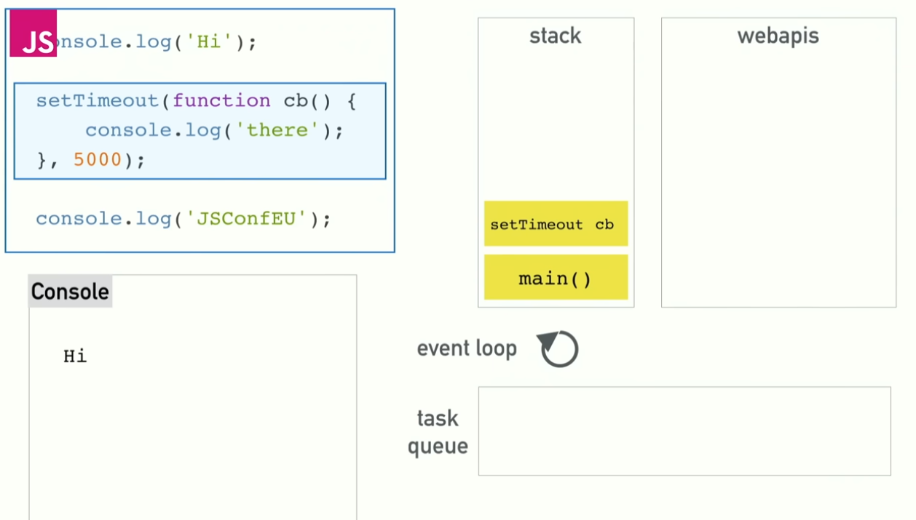
Concurrency & Event Loop

Slide 44
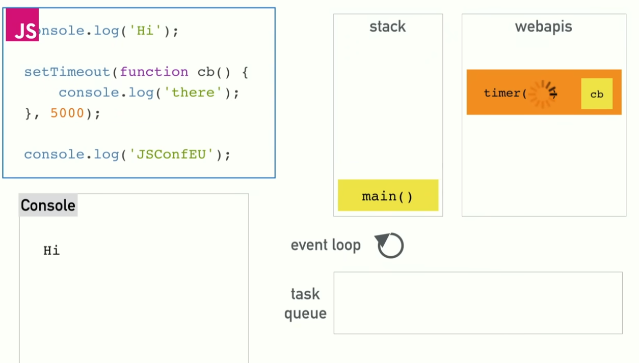
Concurrency & Event Loop

Slide 45
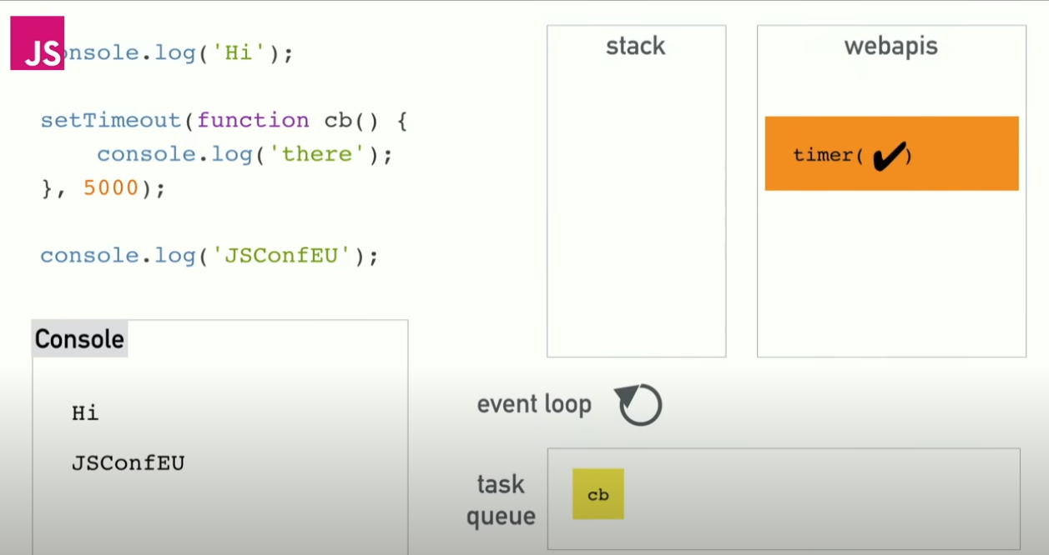
Concurrency & Event Loop

Slide 46
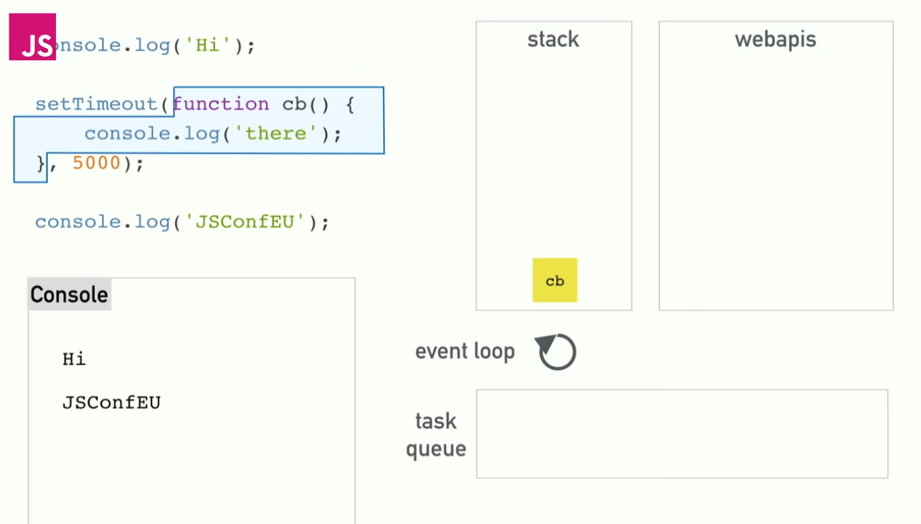
Concurrency & Event Loop

Slide 47
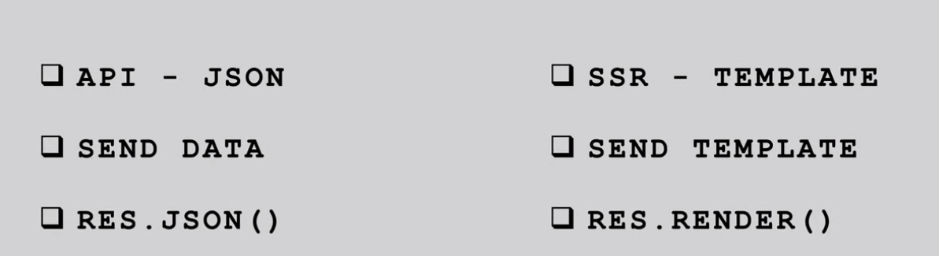
API vs SSR(server side rendering)
API (https://jsonplaceholder.typicode.com/todos)
SSR later in the course

Slide 48
Database Connector:
A database connector, also known as a driver, is a low-level library that provides a direct interface to communicate with a specific database management system (DBMS).
It typically exposes a simple API for executing SQL queries and handling results.
Developers work with raw SQL queries and have full control over the database interactions.
Examples: mariadb connector for MariaDB/MySQL, pg for PostgreSQL, tedious for Microsoft SQL Server.

Slide 49
ORM (Object-Relational Mapping):
An ORM is a higher-level abstraction that maps database tables and records to objects in your programming language.
It provides an object-oriented way of interacting with the database, allowing developers to write code in their programming language instead of writing raw SQL queries.
ORMs handle tasks like querying, inserting, updating, and deleting data using objects and methods, abstracting away the underlying SQL.
Examples: Sequelize, Prisma, TypeORM.

Slide 50
Query Builder:
A query builder is a library that provides a fluent interface for constructing SQL queries programmatically.
It is a middle ground between raw SQL and ORMs, providing a more expressive and readable way of writing SQL queries while still maintaining control over the generated SQL.
Query builders often provide features like query parameter binding, query composition, and database agnostic syntax.
Examples: Knex.js, Slonik.

Slide 51
Summary
Database Connector: Lowest level, provides direct access to the database, requires writing raw SQL queries.
ORM: Highest level of abstraction, hides SQL queries behind an object-oriented interface, maps database tables to objects.
Query Builder: Middle ground, provides a fluent interface for constructing SQL queries programmatically, while still allowing control over the generated SQL.

Slide 52
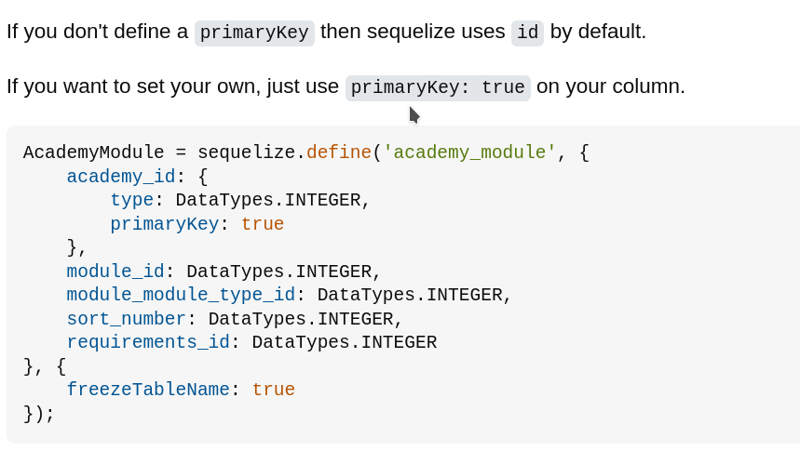
SEQUELIZE
Usually, models have singular names (such as User) while tables have pluralized names (such as Users), although this is fully configurable.
By default, when the table name is not given, Sequelize automatically pluralizes the model name and uses that as the table name. This pluralization is done under the hood by a library called inflection, so that irregular plurals (such as person -> people) are computed correctly.

Slide 53
https://dev.to/kabartolo/how-to-document-an-express-api-with-swagger-ui-and-jsdoc-50do

